Slide 1
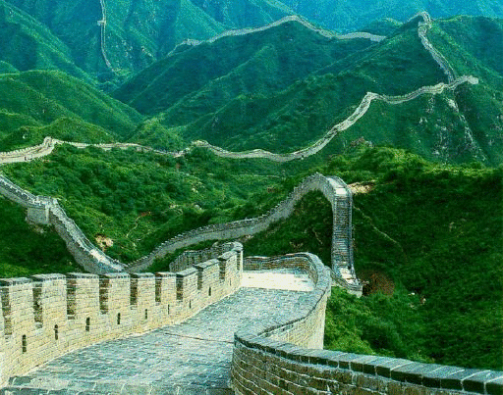
Good Fences Make For Good Neighbors:
Establishing & Maintaining Property Lines
2011 Grant County Rural Landowners Conference
Todd Johnson
UWEX-Grant County
Terry Loeffelholz
Grant County Planning & Zoning
Grant County

Slide 2
Good Fences Make For Good Neighbors:
Establishing & Maintaining Property Lines
2011 Grant County Rural Landowners Conference
Chapter 90 of the Wisconsin State Statute
Responsibility
Legal fence
Resolving disputes
Grant County

Slide 3
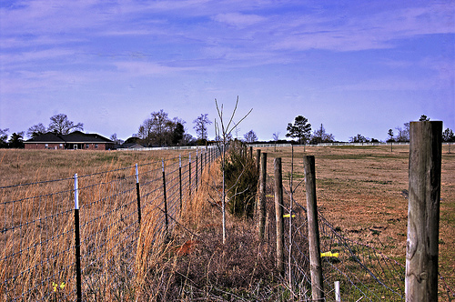
Good Fences Make For Good Neighbors:
Establishing & Maintaining Property Lines
2011 Grant County Rural Landowners Conference
Boundary Disputes
Placement of fence does not determine boundary
Private matters between neighbors
Cannot be settled by town board supervisors
Grant County

Slide 4
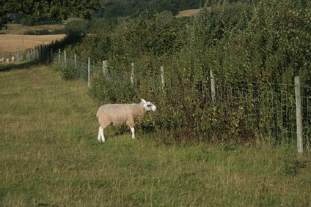
Good Fences Make For Good Neighbors:
Establishing & Maintaining Property Lines
2011 Grant County Rural Landowners Conference
When a Fence is Required
Either adjoining property of two neighbors is used for farming or grazing
Neighbors may agree not to fence
Grant County

Slide 5
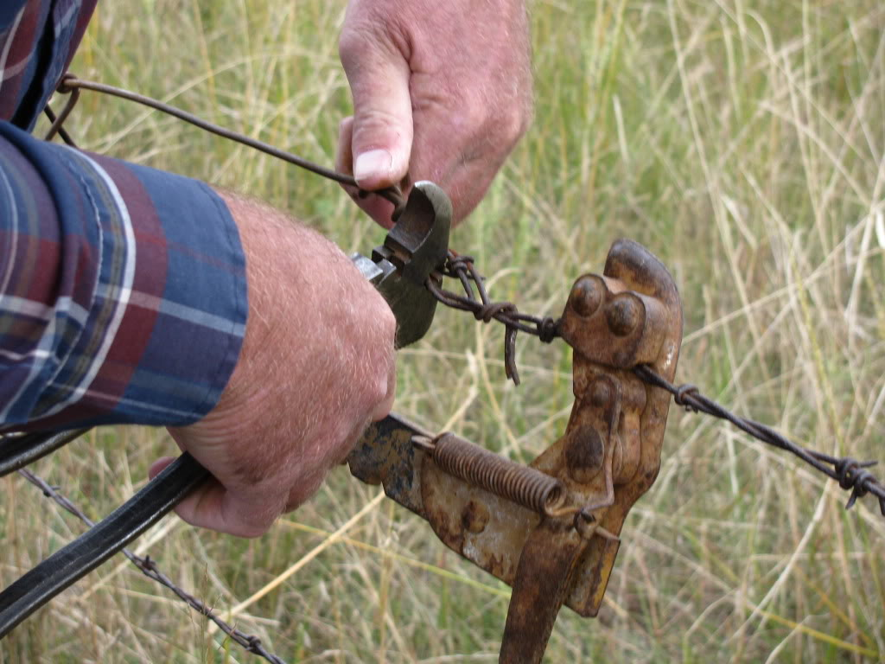
Good Fences Make For Good Neighbors:
Establishing & Maintaining Property Lines
2011 Grant County Rural Landowners Conference
Responsibility
Both neighbors share responsibility
Form an agreement to modify responsibility
Affects liability
Strict liability for specific animals
Grant County

Slide 6
Good Fences Make For Good Neighbors:
Establishing & Maintaining Property Lines
2011 Grant County Rural Landowners Conference
How a Fence is Divided (Partition)
Agreements in writing
Dividing responsibility (right-hand side)
Grant County

Slide 7
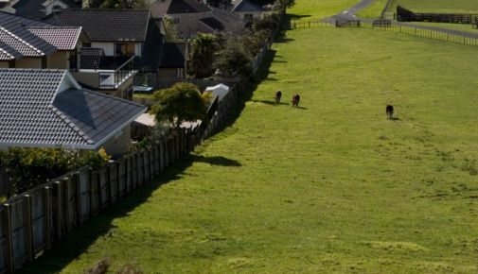
Good Fences Make For Good Neighbors:
Establishing & Maintaining Property Lines
2011 Grant County Rural Landowners Conference
Subdivisions
Next to agricultural land
Ordinance
Agreement
Grant County

Slide 8
Good Fences Make For Good Neighbors:
Establishing & Maintaining Property Lines
2011 Grant County Rural Landowners Conference
Legal Fence
At least 50 inches high
Woven wire, barbed, tensile, boards, electrified
Dimensional requirements per materials
16 feet max.
50 Inches min.
Grant County

Slide 9
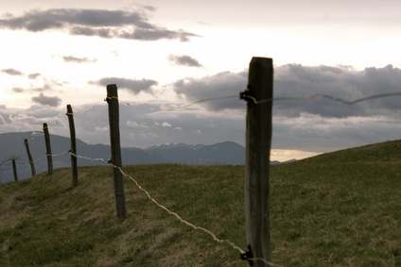
Good Fences Make For Good Neighbors:
Establishing & Maintaining Property Lines
2011 Grant County Rural Landowners Conference
Quiz (Legal or illegal)
Grant County

Slide 10
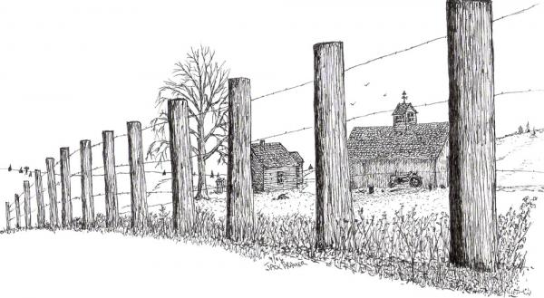
Good Fences Make For Good Neighbors:
Establishing & Maintaining Property Lines
2011 Grant County Rural Landowners Conference
Quiz (Legal or illegal)
Grant County

Slide 11
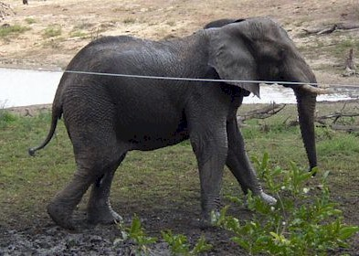
Good Fences Make For Good Neighbors:
Establishing & Maintaining Property Lines
2011 Grant County Rural Landowners Conference
Quiz (Legal or illegal)
Grant County

Slide 12
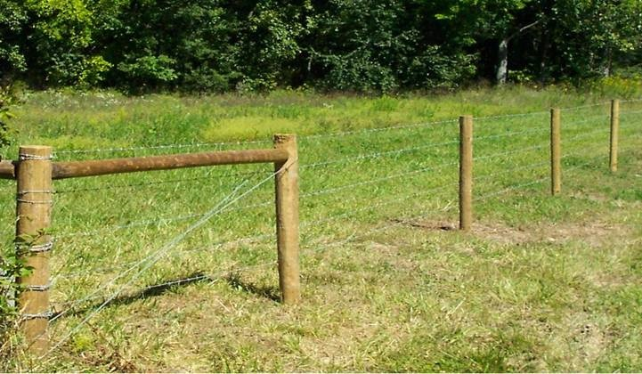
Good Fences Make For Good Neighbors:
Establishing & Maintaining Property Lines
2011 Grant County Rural Landowners Conference
Quiz (Legal or illegal)
Grant County

Slide 13
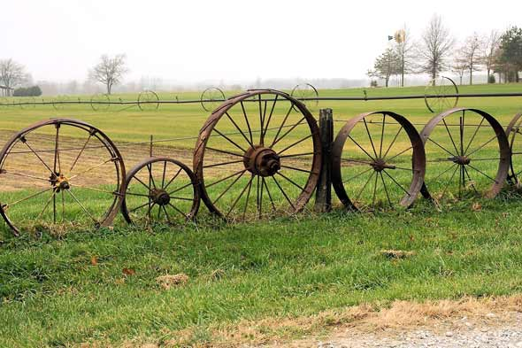
Good Fences Make For Good Neighbors:
Establishing & Maintaining Property Lines
2011 Grant County Rural Landowners Conference
Quiz (Legal or illegal)
Grant County

Slide 14
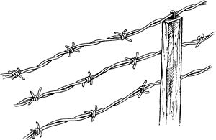
Good Fences Make For Good Neighbors:
Establishing & Maintaining Property Lines
2011 Grant County Rural Landowners Conference
Quiz (Legal or illegal)
Grant County

Slide 15
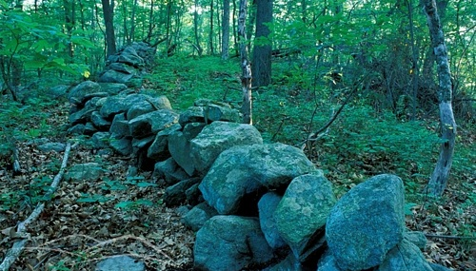
Good Fences Make For Good Neighbors:
Establishing & Maintaining Property Lines
2011 Grant County Rural Landowners Conference
Quiz (Legal or illegal)
Grant County

Slide 16
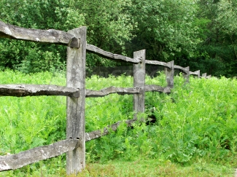
Good Fences Make For Good Neighbors:
Establishing & Maintaining Property Lines
2011 Grant County Rural Landowners Conference
Quiz (Legal or illegal)
Grant County

Slide 17
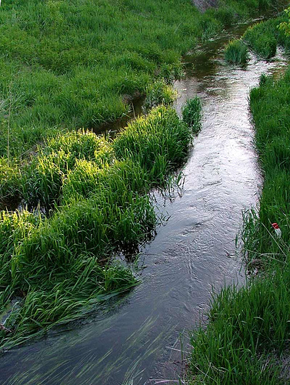
Good Fences Make For Good Neighbors:
Establishing & Maintaining Property Lines
2011 Grant County Rural Landowners Conference
Water Issues
Grant County

Slide 18
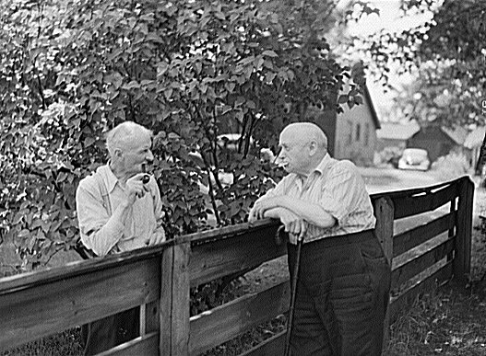
Good Fences Make For Good Neighbors:
Establishing & Maintaining Property Lines
2011 Grant County Rural Landowners Conference
Resolving Disputes & Recovering Costs
Resolve it between neighbors
Town supervisors as fence viewers
Grant County

Slide 19
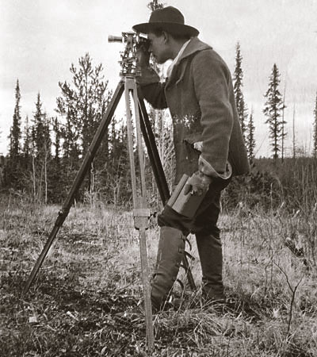
Good Fences Make For Good Neighbors:
Establishing & Maintaining Property Lines
2011 Grant County Rural Landowners Conference
Survey!
Grant County

