Slide 1
Downtown Lancaster Parking Study
Completed by the
International Transportation Engineering (ITE)
UW-Platteville Student Chapter
Presented by:
Stephen Crane
City Administrator

Slide 2
Study Area
16 block section centered on the Courthouse
Area is bordered on the north by County Road A/Elm Street, on the south by Walnut Street, on the west by Harrison Street, and on the east by Monroe Street.
The street parking study area is outlined in purple.
Four surface parking surface lots were also included in this study:
  Public lots: Cherry and Washington Street (St. Clements); Hickory and Washington Street (City lot), and mid-block between Cherry, Maple, Monroe, and Madison Streets.
  Private lot: Elm and Monroe Street (American Bank)

Slide 3
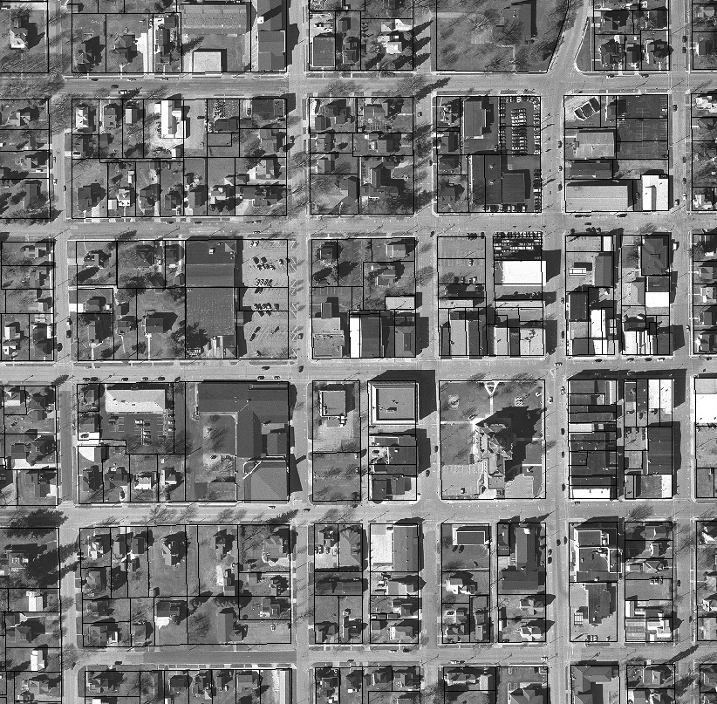
Downtown Parking Study: Study Area

Slide 4
Downtown Parking Study: Daytime Restrictions
2 Hour Parking
30 Min. Parking
Handicap Parking

Slide 5
Data Collection
The total number of spaces, those number of available spaces, and the number of occupied spaces at a given time within the study area.
Parking spaces were also identified by designation (e.g. 2 hour parking, 30 minute parking, and 15 minute parking).
Each study was performed on different day of the week, with Tuesday being repeated (Monday through Thursday), and at a different time.
Times studied were 8AM (2/23), 11AM (3/15), 12PM (2/22), 2PM (3/3), and 4PM (2/14).
A jury trial selection on March 15 was studied as there was concern about jury candidates not having sufficient parking.

Slide 6
Downtown Parking Study: Monday, February 14 @4PM
Used
Total

Slide 7
Downtown Parking Study: Monday, February 14 @4PM
No Parking
Used
No Parking
Total

Slide 8
Downtown Parking Study: Tuesday, February 22 @12PM
Used
Total

Slide 9
Downtown Parking Study: Tuesday, February 22 @12PM
No Parking
Used
No Parking
Total

Slide 10
Downtown Parking Study: Wednesday, February 23 @ 8AM
Used
Total

Slide 11
Downtown Parking Study: Wednesday, February 23 @8AM
No Parking
Used
No Parking
Total

Slide 12
Downtown Parking Study: Thursday, March 3 @2PM
Used
Total

Slide 13
Downtown Parking Study: Thursday, March 3 @2PM
No Parking
Used
No Parking
Total

Slide 14
Downtown Parking Study: Tuesday, March 15 @11AM
Jury Trial
Used
Total

Slide 15
Downtown Parking Study: Tuesday, March 15 @11AM
No Parking
Used
No Parking
Total

Slide 16
By the Numbers
 | Average | Maximum
Total Available Parking Stalls (Street) | 692 | 692
Total Used Parking Stalls (Street) | 183.6 | 194
Percentage of Stalls Used (Street) | 27% | 28%
 | Average | Maximum
Total Available Parking Stalls (Lot) | 165 | 165
Total Used Parking Stalls (Lot) | 105.1 | 108
Percentage of Stalls Used (Lot) | 64% | 65%

Slide 17
Analysis
Data was sorted by blocks to determine if certain zones were prone to parking issues.
Spaces counted were on the inside of the streets.
The outside perimeter of the study area was not included in the study of the individual blocks.
The blocks with the highest percentage of stalls used were Blocks 8 and 10 with 77 percent of maximum stalls used.

Slide 18
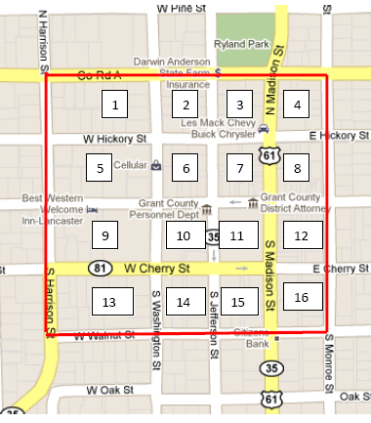
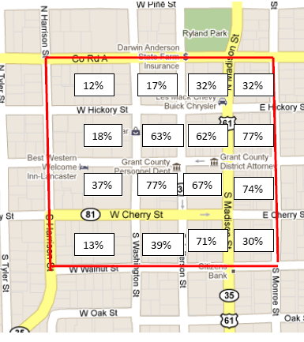
Analysis

Slide 19
Conclusions
The street with the highest maximum percentage was Maple Street with maximum used percentage of 59 percent.
Harrison Street was the least parked on street with a maximum use percentage of only 10 percent.
The highest used block percentage was 77 percent, which means that still stalls open at peak demand.
Within a block of the highest used blocks are blocks with less than 40 percent being used at peak.

Slide 20
Conclusions (cont’d.)
It can be concluded that parking is not a major issue in the study area.
There is sufficient parking in all parts of the study area.
Study results are nearly identical to 1999 study even with a smaller study area.

Slide 21
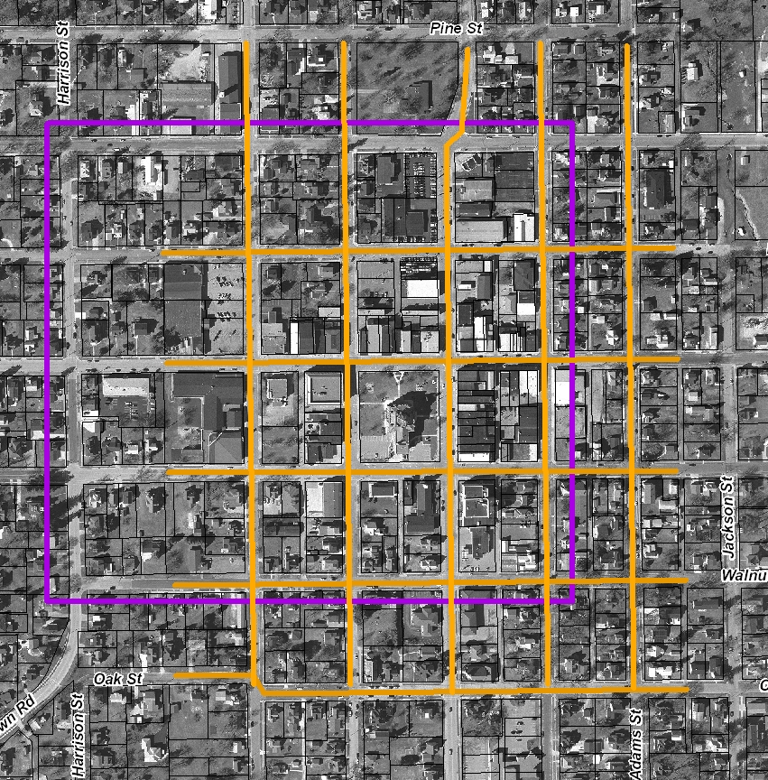
Study Area:
857 Spaces
1999 Study Area:
1177 Spaces

Slide 22
Recommendations
It is recommended that no major changes be made to the parking in the study area. IF changes are needed:
  Elm and Monroe Street parking lot should be used for public parking
  Place signs directing vehicles to park on streets that are underused.
Further analysis could be done to assess the unique customer needs for customers of government buildings.
  These unique needs may result in the need of establishing special zones for drop/pickup and parking to meet their needs.

Slide 23
What It Means
There is ample parking to accommodate use of the third floor.
A street space is just as good as a parking lot—and much less expensive.
Jobs and services are more important than parking spaces.

Slide 24
If I Was In Your Shoes…
Evaluate all current space assignments in Administration Building.
Evaluate cost of private leases versus finishing third floor and rehabilitating the “52” building.
If consolidation is pursued, all County functions should be “on the table” and new space assignments should reflect unique customer needs.
When pursuing efficiency, the best option is not always the cheapest one.

Slide 25
The End
Any Questions?

