Slide 1
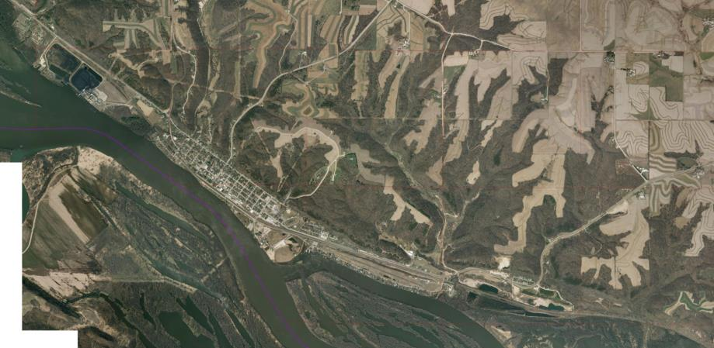
Cassville Riverwalk
Grant County

Slide 2
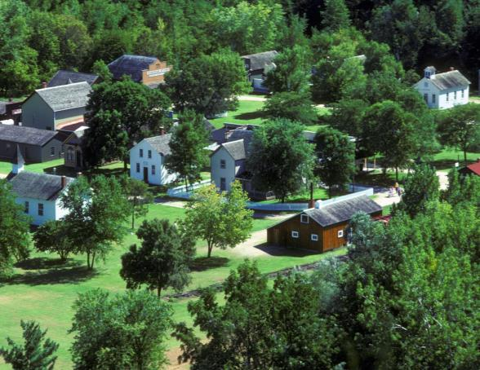
Cassville Riverwalk
Grant County

Slide 3
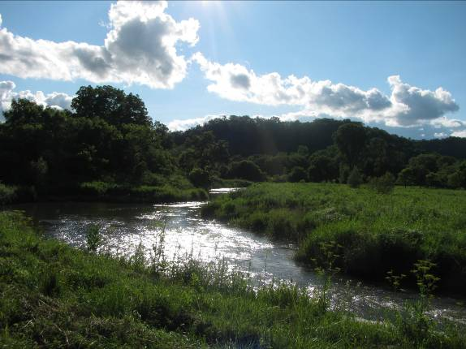
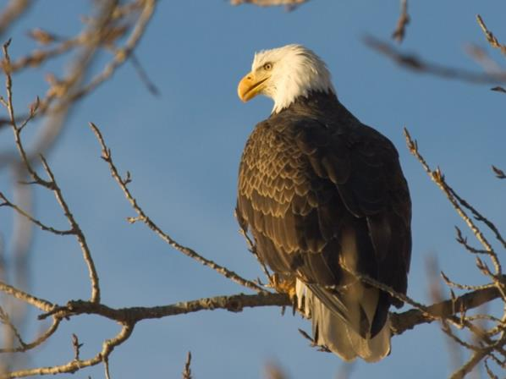
Cassville Riverwalk
Grant County

Slide 4
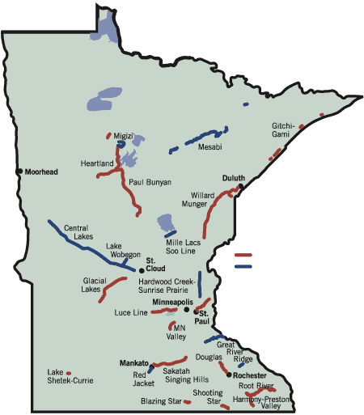
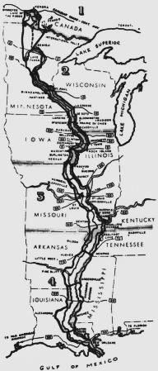
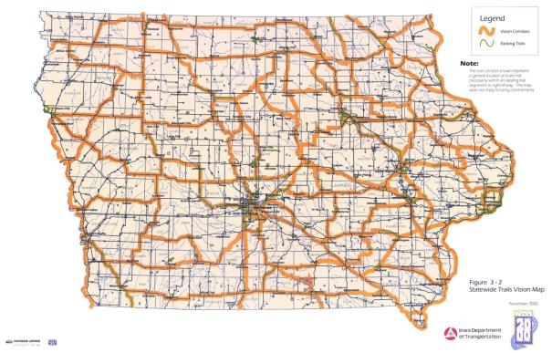
Cassville Riverwalk
Grant County

Slide 5
Cassville Riverwalk
Lanesboro, MN Population 754
2014 Smithsonian Top-10 Best Small Towns to Visit in USA
Grant County

Slide 6
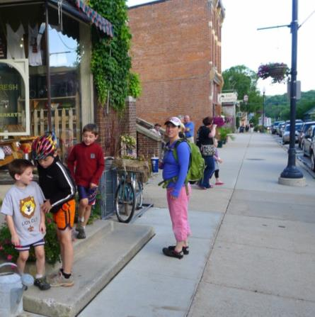
Cassville Riverwalk
Lanesboro, MN Population 754
2014 Smithsonian Top-10 Best Small Towns to Visit in USA
Grant County

Slide 7
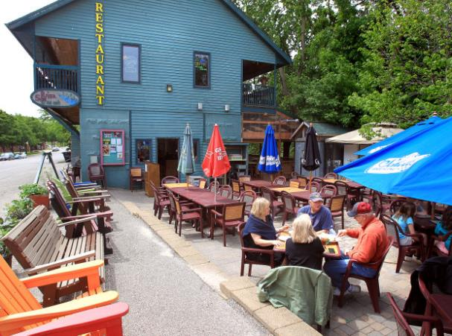
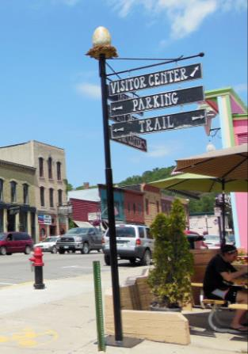
Cassville Riverwalk
Lanesboro, MN Population 754
2014 Smithsonian Top-10 Best Small Towns to Visit in USA
Grant County

Slide 8
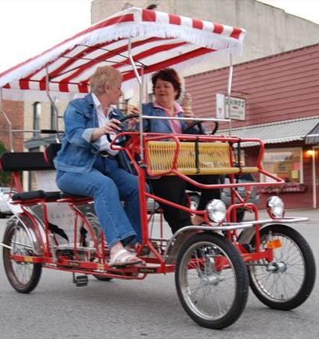
Cassville Riverwalk
Lanesboro, MN Population 754
2014 Smithsonian Top-10 Best Small Towns to Visit in USA
Grant County

Slide 9
Cassville Riverwalk
Grant County

Slide 10
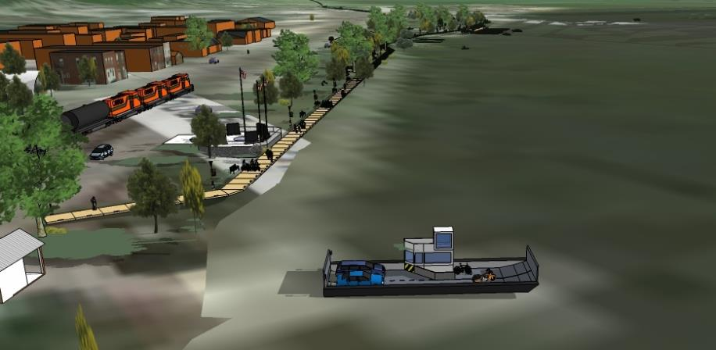
Cassville Riverwalk
Grant County

Slide 11
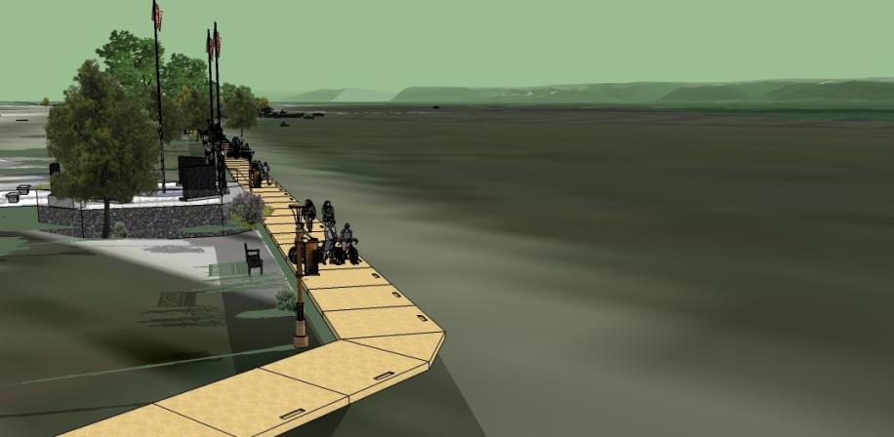
Cassville Riverwalk
Grant County

Slide 12
Cassville Riverwalk
Grant County

Slide 13
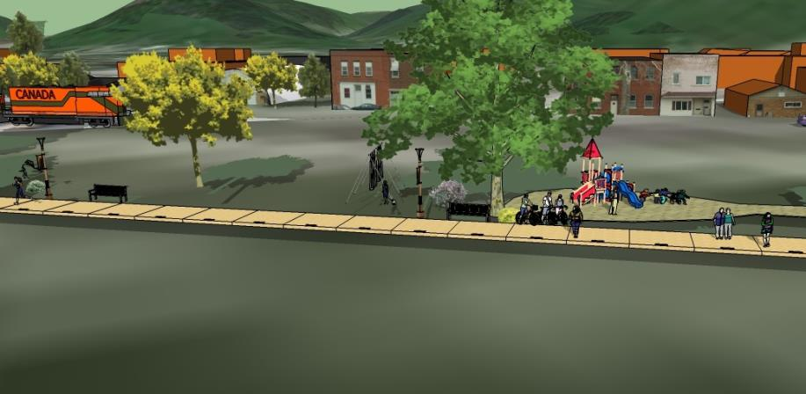
Cassville Riverwalk
Grant County

Slide 14
Cassville Riverwalk
Grant County

Slide 15
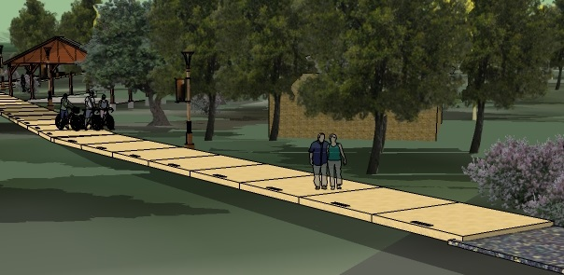
Cassville Riverwalk
Grant County

Slide 16
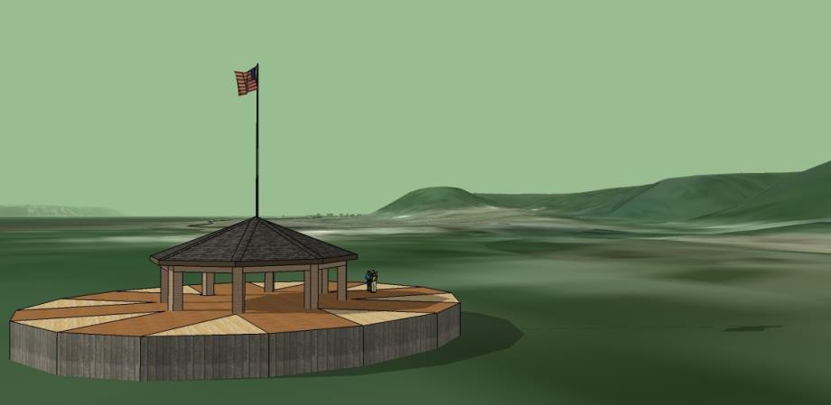
Cassville Riverwalk
Grant County

Slide 17
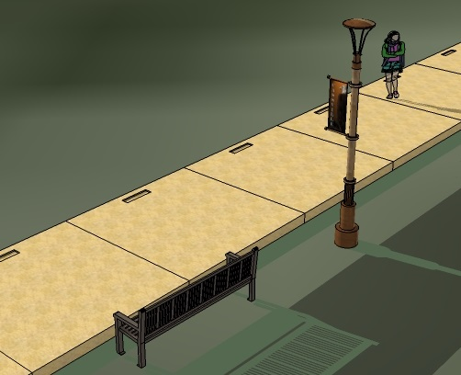
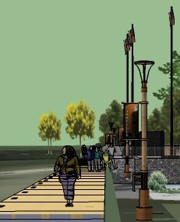
Cassville Riverwalk
Grant County

