Slide 1
Grant County Departmental Space Needs Assessment
Grant County

Slide 2
Grant County Departmental Space Needs Assessment
Purpose
Find an internal use for the 3rd floor
of the Administration Building.
Grant County

Slide 3
Grant County Departmental Space Needs Assessment
Approach
Set parameters
Collect data
Develop alternatives
Committee recommendation
Board decision
Grant County

Slide 4
Grant County Departmental Space Needs Assessment
Set parameters
Building spaces
Departments
Roles & responsibilities
Grant County

Slide 5
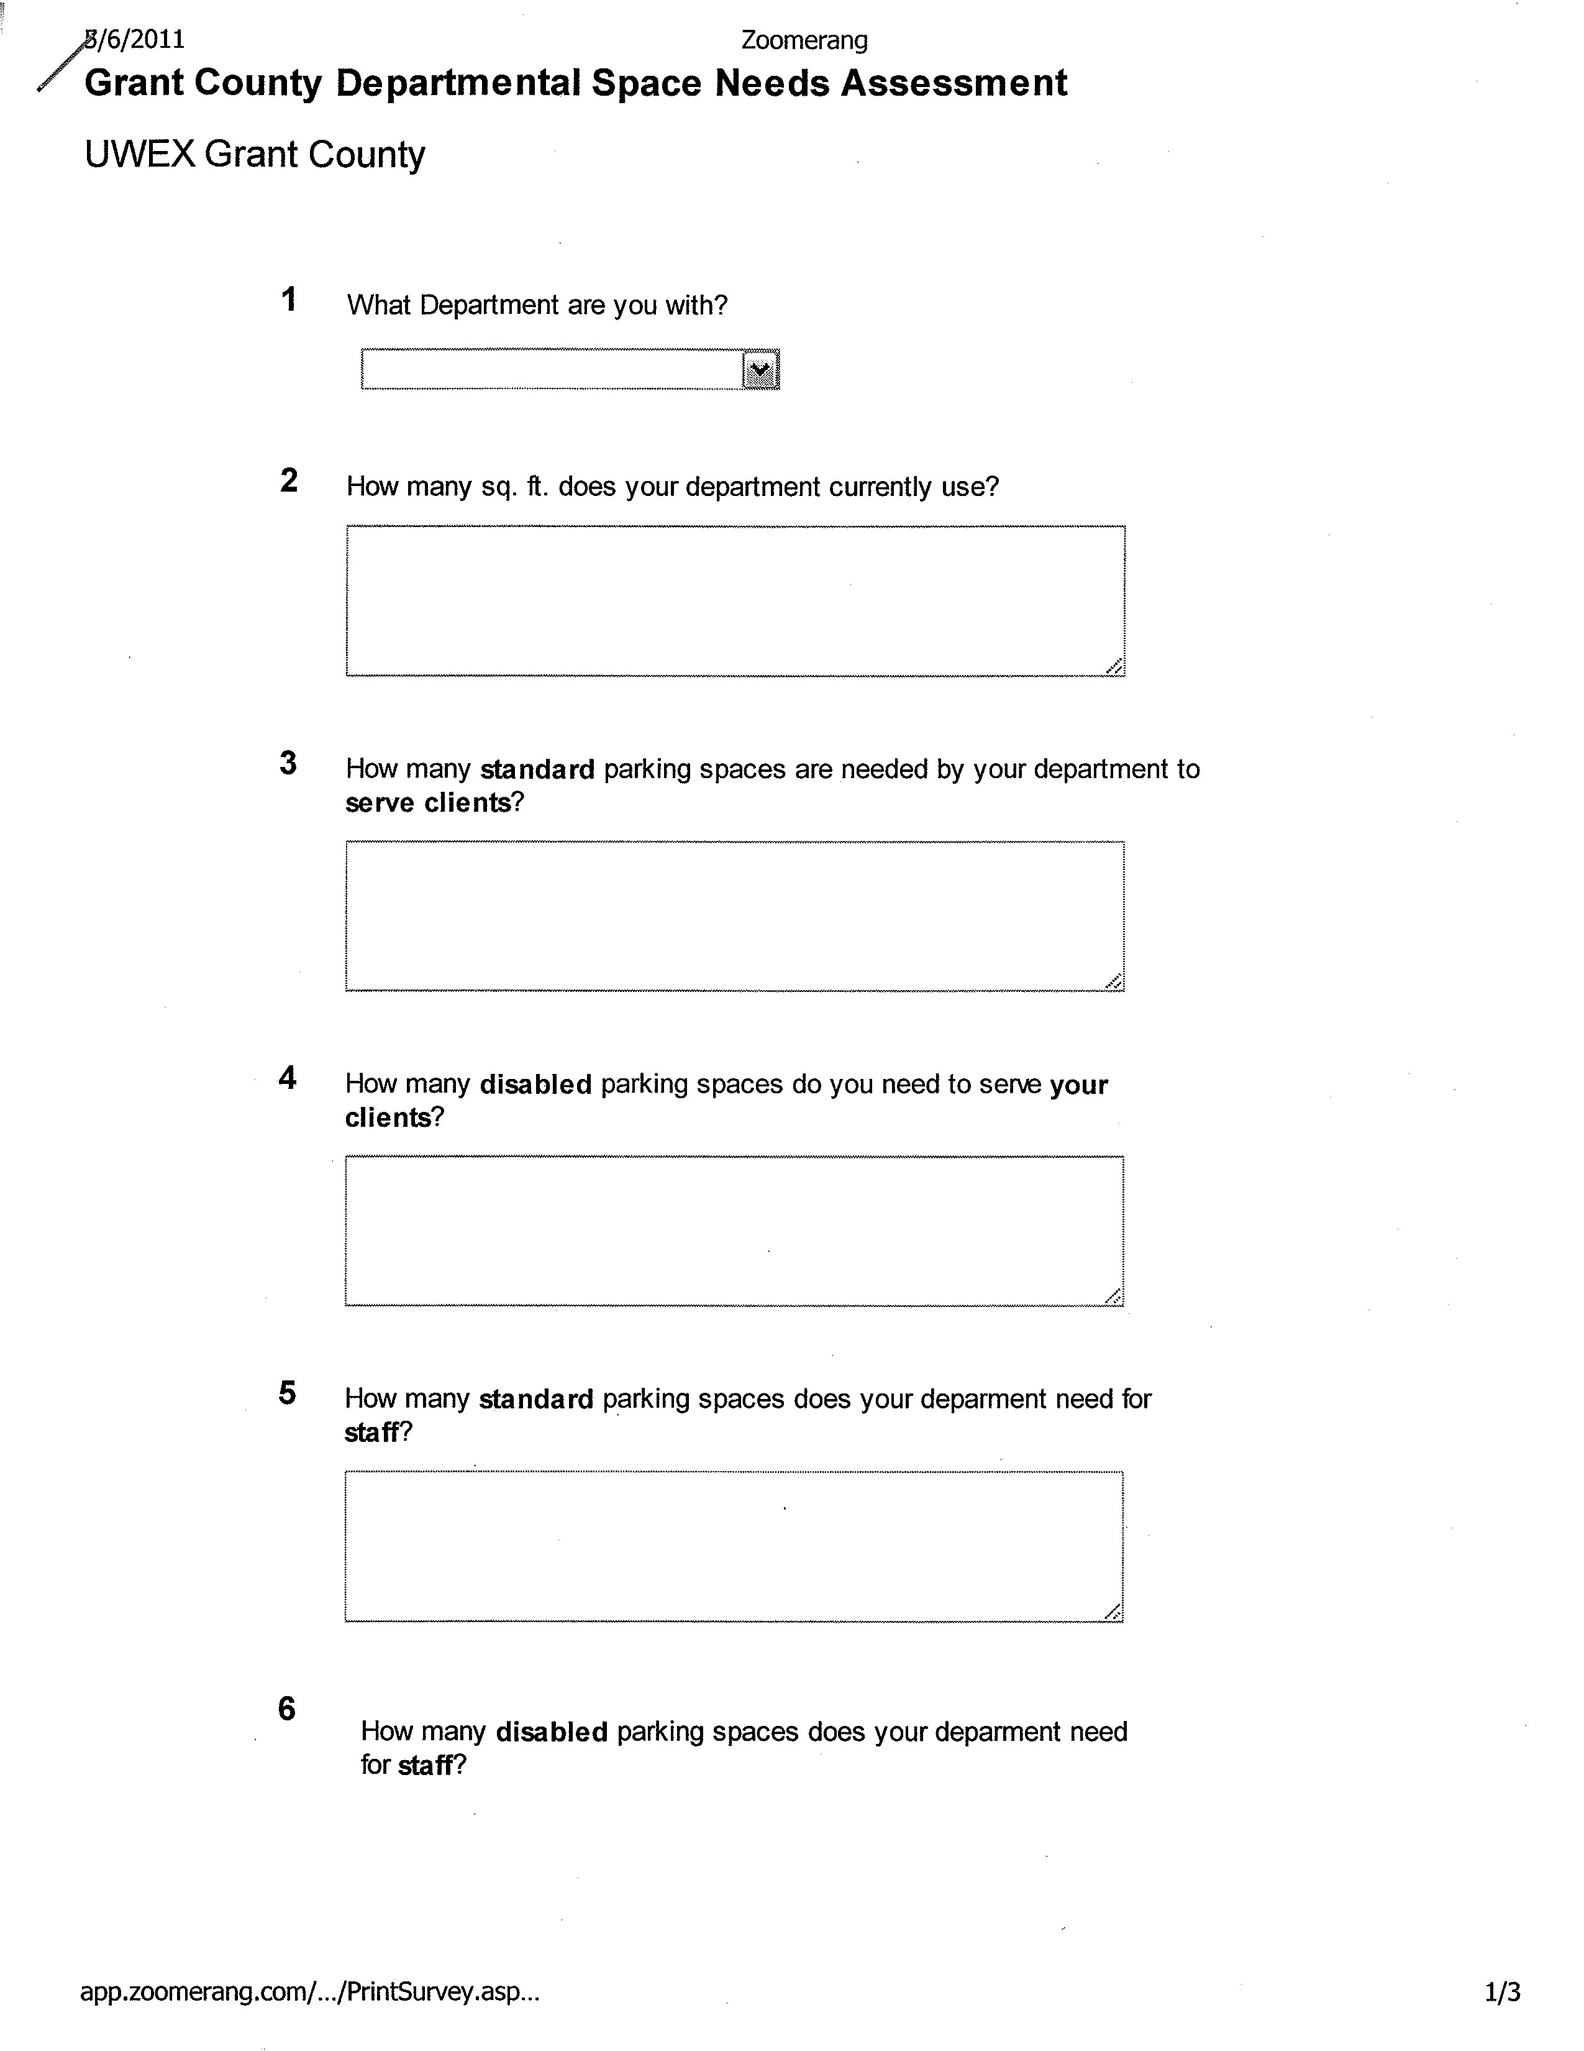
Grant County Departmental Space Needs Assessment
Collect data
ADRC
30/12
3/2
Land & Water
12/5
2/1
Zoning
3/4
1/1
Land Info
3/6
2/1
Grant County

Slide 6
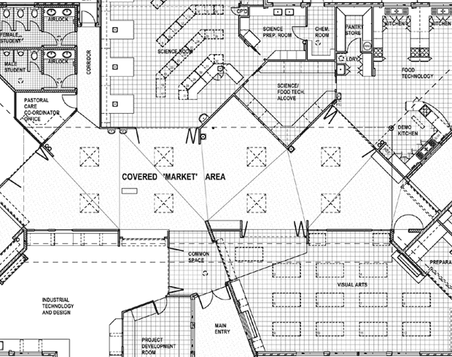
Grant County Departmental Space Needs Assessment
Develop alternatives
ADRC
30/12
3/2
ADRC
30/12
3/2
Land & Water
12/5
2/1
Zoning
3/4
1/1
Land Info
3/6
2/1
ADRC
30/12
3/2
Land Info
3/6
2/1
Zoning
3/4
1/1
Land & Water
12/5
2/1
Zoning
3/4
1/1
ADRC
30/12
3/2
Land Info
3/6
2/1
Land & Water
12/5
2/1
Land & Water
12/5
2/1
Zoning
3/4
1/1
Land Info
3/6
2/1
Grant County

Slide 7
Grant County Departmental Space Needs Assessment
Committee makes recommendation
ADRC
30/12
3/2
Land & Water
12/5
2/1
Zoning
3/4
1/1
Land Info
3/6
2/1
ADRC
30/12
3/2
Land Info
3/6
2/1
Zoning
3/4
1/1
Zoning
3/4
1/1
ADRC
30/12
3/2
Land Info
3/6
2/1
Land & Water
12/5
2/1
Land & Water
12/5
2/1
Grant County

Slide 8
Grant County Departmental Space Needs Assessment
Board makes final decision
ADRC
30/12
3/2
Land & Water
12/5
2/1
Zoning
3/4
1/1
Land Info
3/6
2/1
Grant County

Slide 9
Grant County Departmental Space Needs Assessment
Schedule
Set parameters: Today
Collect data: May
Develop alternatives: June
Committee recommendation: July
Board decision: July
Grant County

Slide 10
Grant County Departmental Space Needs Assessment
Grant County

