Slide 1
County Board Size: Outline
Looking Inward
Looking Outward
Looking Forward
Grant County

Slide 2
Looking Inward: Outline
Average Number of Meetings Per Year
Committee Meeting Length
Committee Productivity
Number of Committees Per Supervisor
Annual Service Hours Per Supervisor
Average Total Time Spent Each Year
Est. Number of Service Hours Per Board Size
Grant County

Slide 3
Average Number of Meetings Per Year
(By Committee)
Grant County

Slide 4
Committee Meeting Length
(By Committee)
Grant County

Slide 5
Average Committee Productivity
Grant County

Slide 6
Number of Committees Per Supervisor
Grant County

Slide 7
Annual Service Hours Per Supervisor
(Committee Time + 30 hours for County Board Meetings)
Average
Grant County

Slide 8
Average Total Committee Time Spent Each Year
Grant County

Slide 9
Estimated Number of Individual Service Hours A Year
(Per Board Size)
4,744.7 hours
Number of Supervisors
Y=
+ 30 hours
Grant County

Slide 10
Looking Outward: Outline
County Comparisons
Number of Committees
Board Size
Representation
Grant County

Slide 11
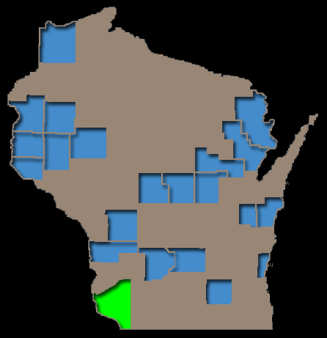
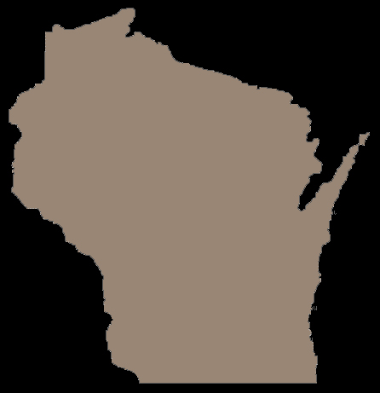
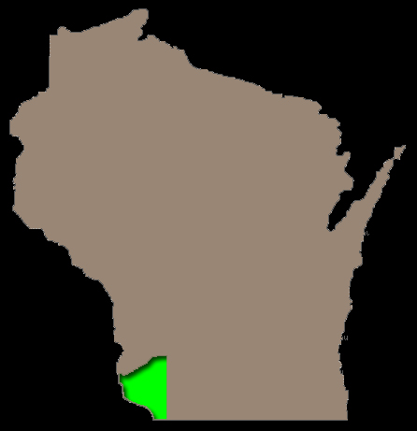
County Comparison
(Similar Population)
Grant County

Slide 12
2010 Population Estimates
(Similar County Population)
Grant County

Slide 13
Number of Committees
(Similar County Population)
Grant County

Slide 14
County Board Size
(Similar County Population)
Grant County

Slide 15
Representation by Each Supervisor
(Similar County Population)
Grant County

Slide 16
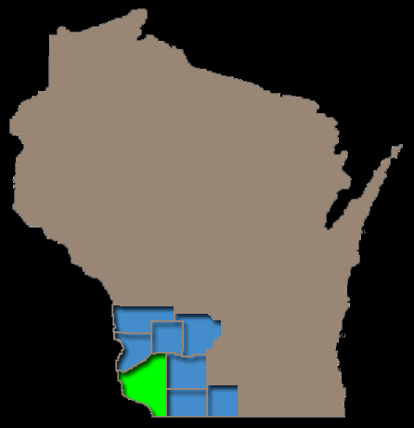
County Comparison
(Southwestern Wisconsin)
Grant County

Slide 17
Number of Committees
(Southwestern Wisconsin)
Grant County

Slide 18
County Board Size
(Southwestern Wisconsin)
Grant County

Slide 19
Representation by Each Supervisor
(Southwestern Wisconsin)
Grant County

Slide 20
Looking Outward: Summary
Number of Committees
Number of Supervisors
Representation by Each Supervisor
Grant County

Slide 21
Grant County Supervisor Poll Average
(Recommended Number of Supervisors)
21
Grant County

Slide 22
Looking Forward
Number of Committees
Activities Within Committees
Representation
Board Size
Grant County

